Slide 1
Feasibility of Beam Reinforcement Optimization for Practical Application
Advisor : Prof. K.C.Chang
Presenters : You-Ran Nai
Notes:
Try 講清楚脈絡

Slide 2
Outline
Part 2
Part 4
Methodology
Seismic Verification
Part 1
Part 3
Objective
Condition

Slide 3
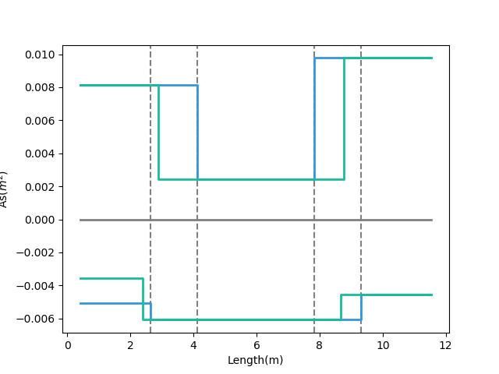
- Tradition
- Multi-Cut-2
梁用鋼量圖
12-#10
10-#10
REDUCE REBAR
Top Rebar
3-#10
7-#8
9-#8
Bottom Rebar
Real
Demand
12-#8
Notes:
LowSeismic4Floor12M 0

Slide 4
- Tradition
- Multi-Cut-2
梁用鋼量圖
12-#10
10-#10
REDUCE REBAR
Top Rebar
3-#10
7-#8
9-#8
Bottom Rebar
Real
Demand
12-#8
Notes:
LowSeismic4Floor12M 0

Slide 5
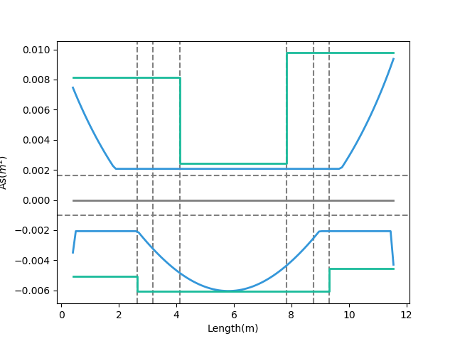
- Design As
12-#10
10-#10
- Demand As
Today’s Solution
Fixed Bar-Cut
3-#10
Top Rebar
10-#8
9-#8
12-#8
Bottom Rebar
Notes:
LowSeismic4Floor12M 0

Slide 6
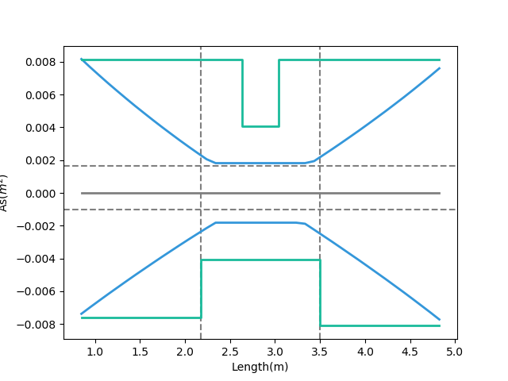
Tradition
- Design As
- Demand As
Top Rebar
Bottom Rebar
Notes:
欣銓 1140

Slide 7
Outline
Part 2
Part 4
Algorithm
Seismic Verification
Part 1
Part 3
Objective
Condition

Slide 8
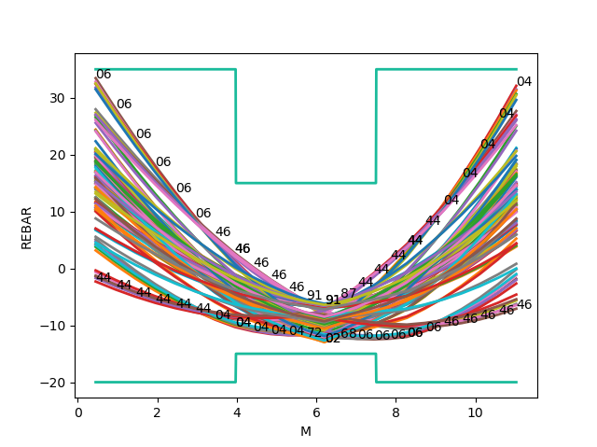
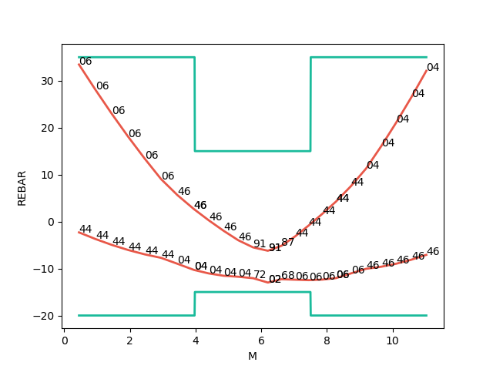
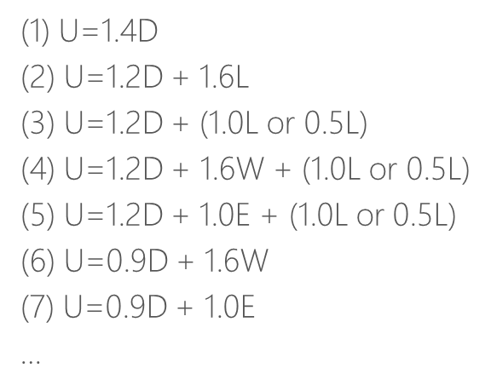
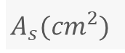

Mu
Consider Hundreds Of Combo Demand
Catch Critical Demand Combo
$$A_{s}({cm}^{2})$$
$$A_{s}({cm}^{2})$$
Length(m)
Length(m)

Slide 9
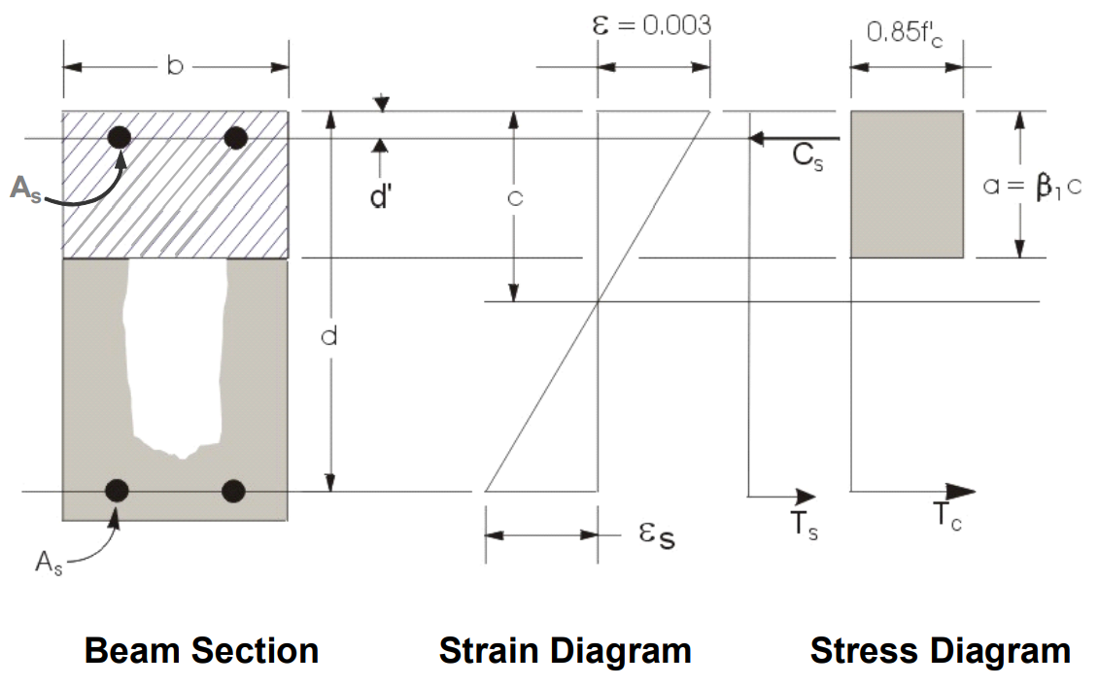
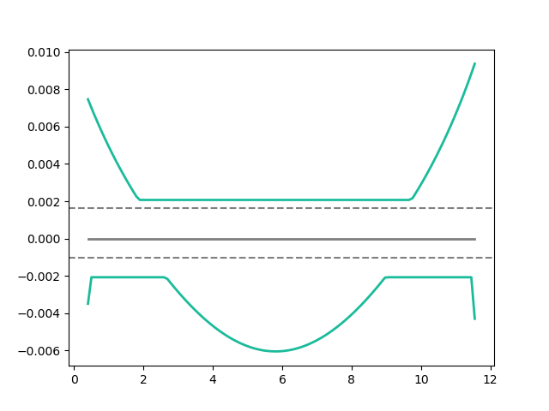
Flexural Reinforcement
- Demand As
Min: 2 Rebar
Notes:
LowSeismic 4Floor 12M 0

Slide 10
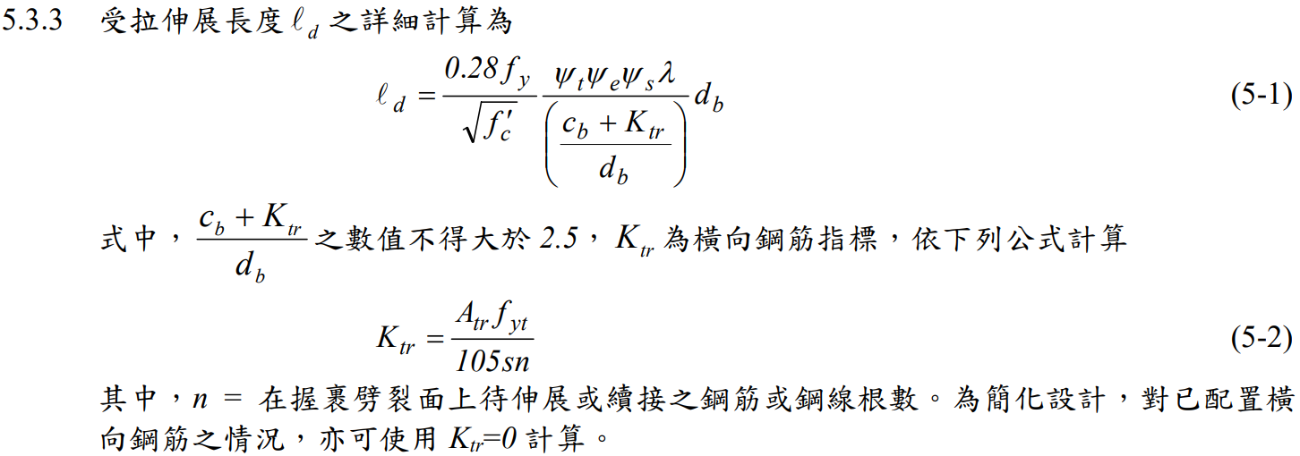
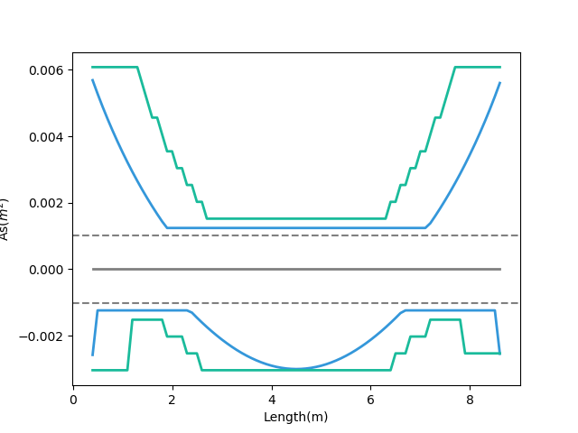
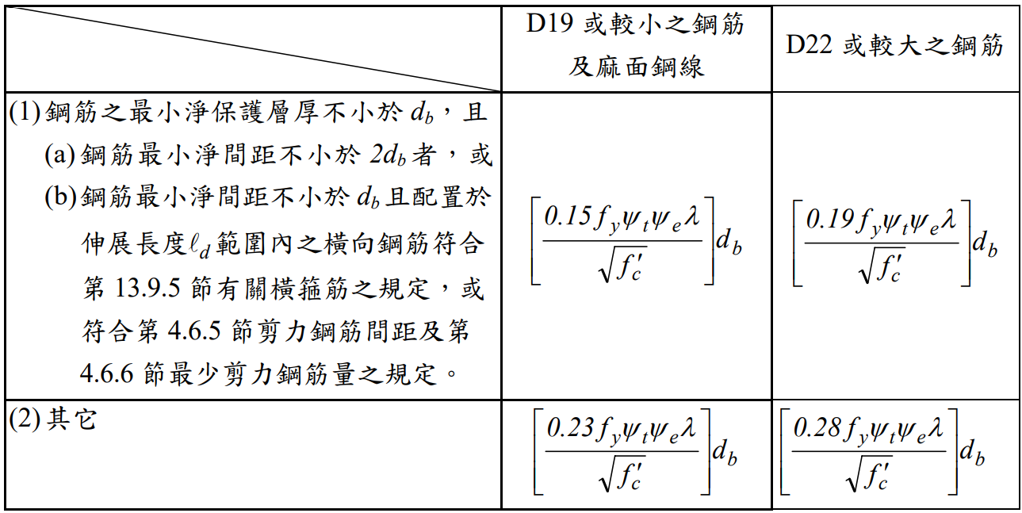
General Development Length Equation
- Demand As
- After Consider Ld As
Top
MIN
Simplified Provisions
Bottom
Ld
Notes:
LowSeismic 4Floor 12M 0

Slide 11
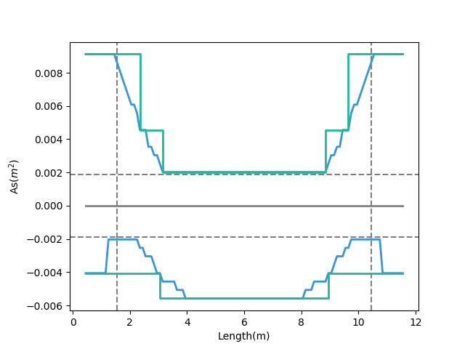
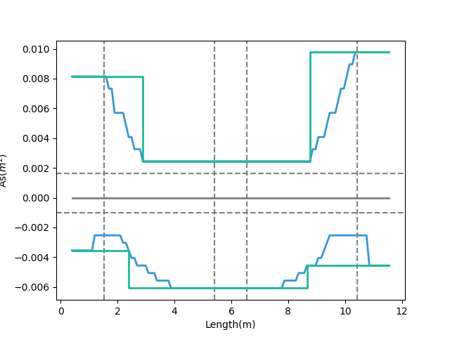
Combinations
Multi-Cut-4
Multi-Cut-2
- Consider Ld
Top
Bottom
0.1
Ln
0.9
Ln
- Consider Ld
Notes:
GA 演算法
LowSeismic 4Floor 12M 4
LowSeismic 4Floor 12M 0

Slide 12
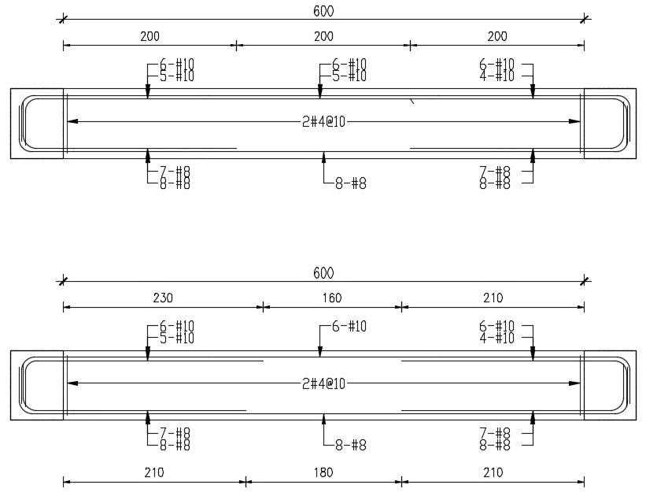
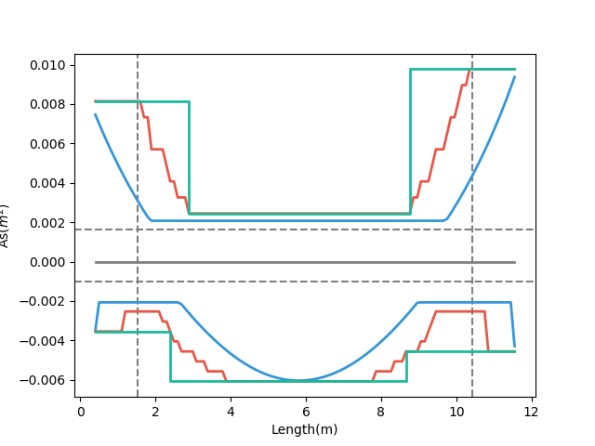
- Demand As
傳統梁鋼筋配置圖
- Consider Ld As
- Design As
Multi-Cut-2
多點斷筋梁鋼筋配置示意圖
Notes:
LowSeismic 4Floor 12M 0

Slide 13


Slide 14
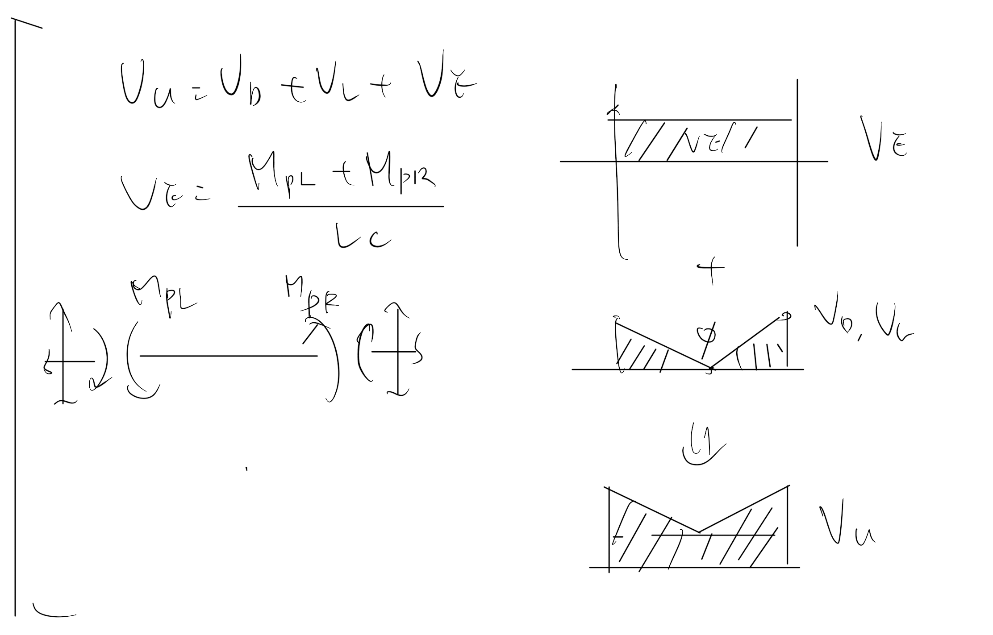
Vu
Notes:
LowSeismic4Floor12M 0

Slide 15
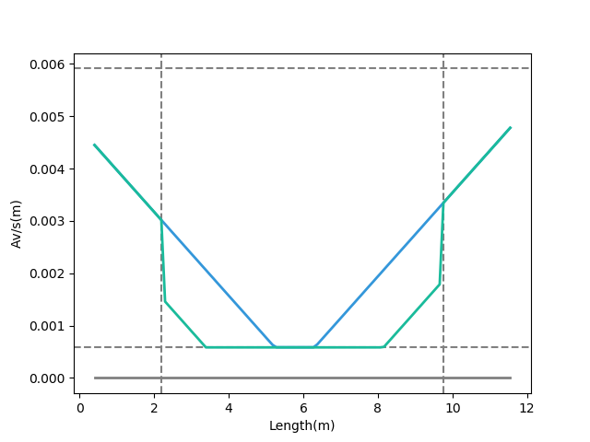
Shear Reinforcement
- Vu
- Vs
Notes:
LowSeismic4Floor12M 0

Slide 16
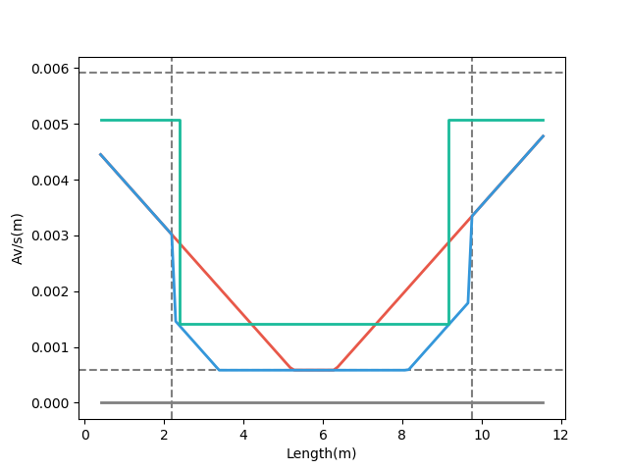
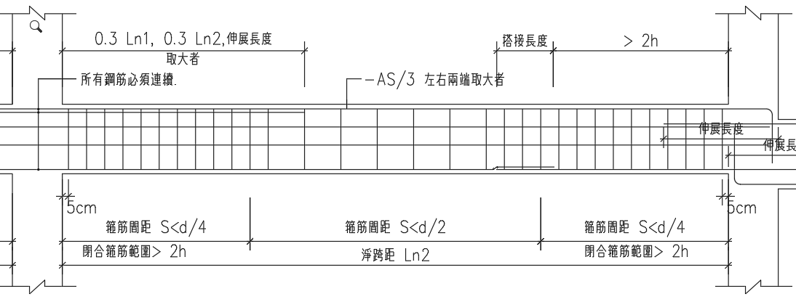
- Demand
- Consider Vc
- Design Av
梁剪力鋼筋配置示意圖
Notes:
LowSeismic4Floor12M 0

Slide 17
Outline
Part 2
Part 4
Algorithm
Seismic Verification
Part 1
Part 3
Objective
Condition

Slide 18
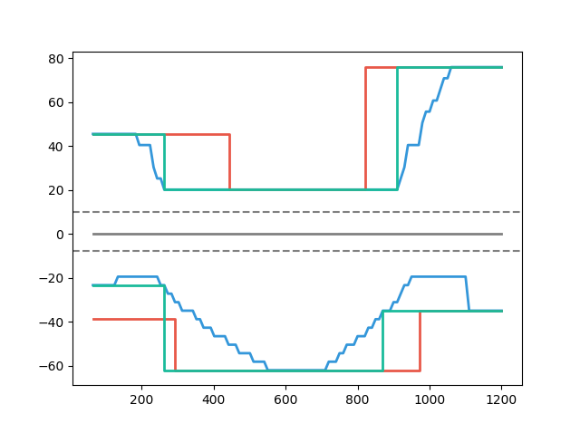
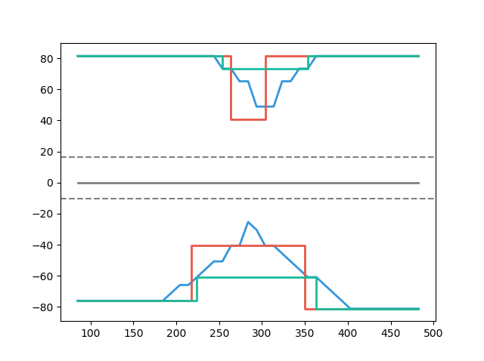
Multi-Cut-2 vs Tradition
- Tradition
- Consider Ld
- Tradition
- Consider Ld
- Multi-Cut-2
Multi-Cut-2 82%
Top
As(cm2)
As(cm2)
Multi-Cut-2 91%
Bottom
Length(cm)
Length(cm)
Notes:
傳統不經濟
828
傳統不保守 不符合 混凝土結構設計規範 401-100 R5.11.2
1140

Slide 19
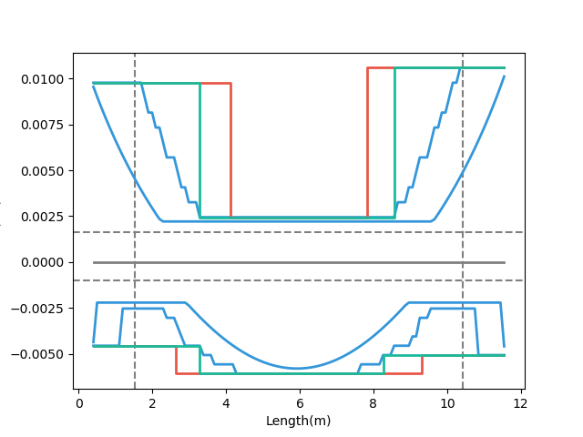
Factor
- Demand
- Tradition
- Multi-Cut-2
Moment
Consider Ld
Tradition

Slide 20
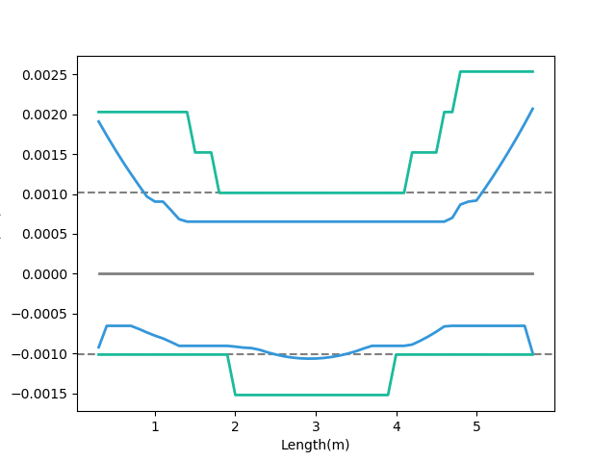
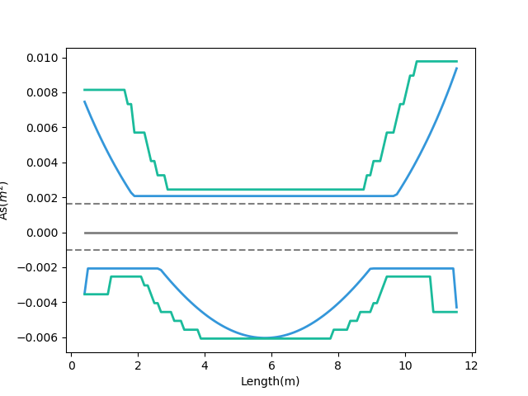
Ld
- Consider Ld
- Demand
Short Development Length
Ld
- Consider Ld
- Demand
Beam Length
Notes:
LowSeismic4Floor12M 0

Slide 21
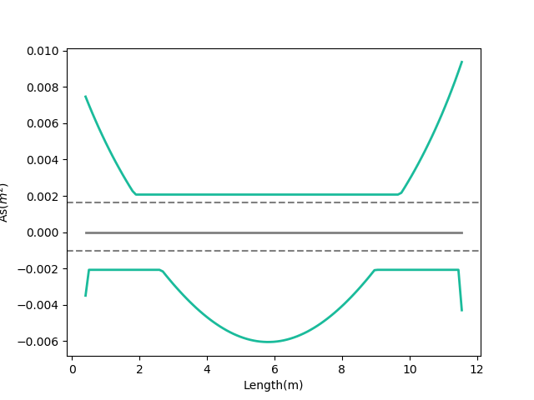
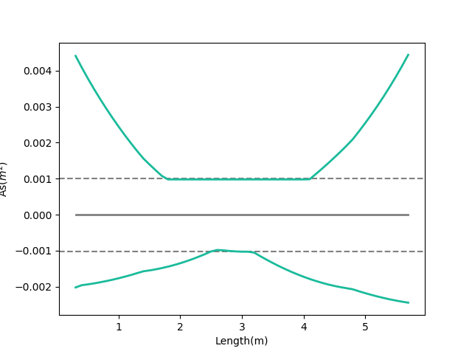
Moment Decay
- Moment Demand As
- Moment Demand As
Large Slope
Small Slope
Notes:
LowSeismic4Floor12M 0

Slide 22
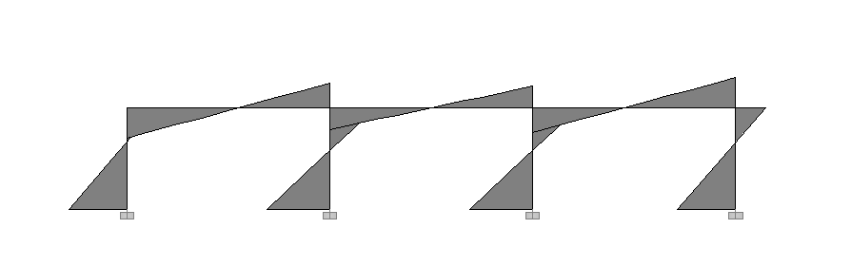
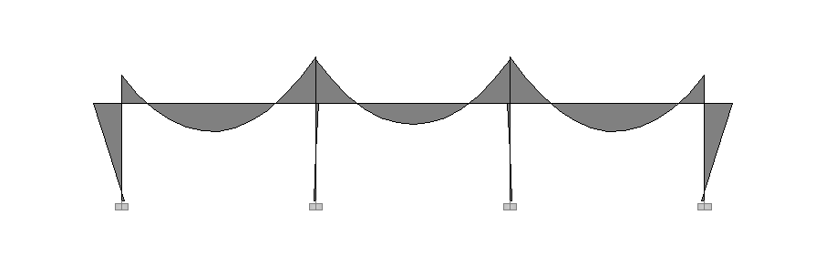
Lateral Load
Lateral
Force
Moment Diagram
Gravity Load
Gravity Load

Slide 23
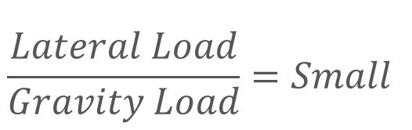
Lateral
Force
Moment Decay
$$\frac{Lateral Load}{Gravity Load}=Small$$
Gravity Load
Beam Length
Story Height

Slide 24
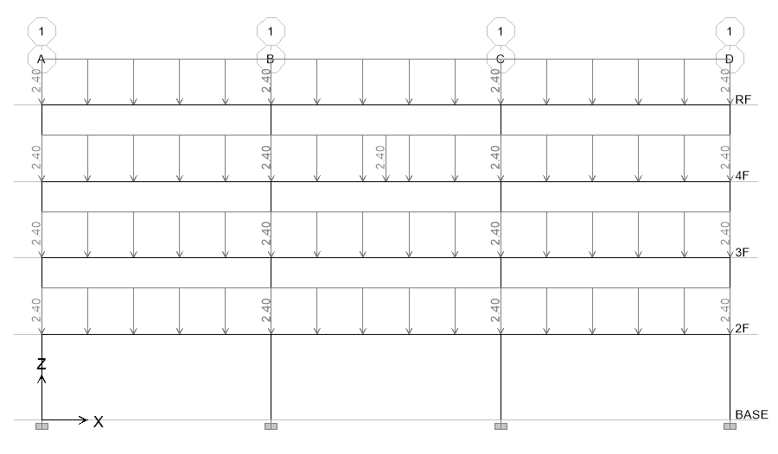
22 Models
4m
4.5m
Notes:
LowSeismic4Floor12M 0

Slide 25
Result
Beam Length
6m
9m
12m
High Seismic
99.6%
94.2%
92.1%
Site
Middle Seismic
99.6%
95.3%
91.0%
Low Seismic
98.1%
94.5%
90.4%

Slide 26
Result
Beam Length
6m
9m
12m
High Seismic
99.6%
94.2%
92.1%
Site
Middle Seismic
99.6%
95.3%
91.0%
Low Seismic
98.1%
94.5%
90.4%

Slide 27
Story Result
Beam Length
6m
9m
12m
Top Story
97.8%
93.7%
89.8%
Bottom Story
100.2%
95.5%
92.3%

Slide 28
Bottom Result
Beam Length
6m
9m
12m
High Seismic
97.2%
89.0%
95.1%
Site
Middle Seismic
91.9%
94.3%
97.2%
Low Seismic
96.0%
99.4%
96.5%

Slide 29
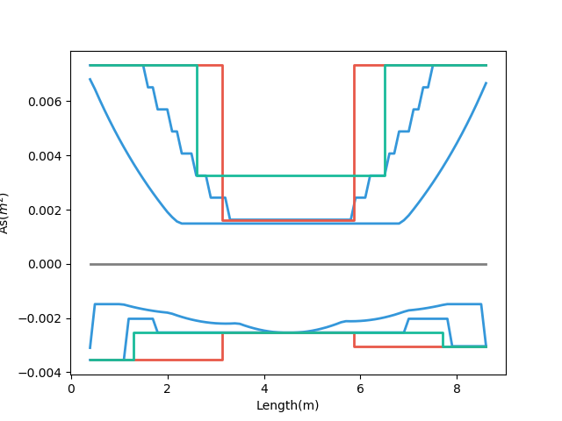
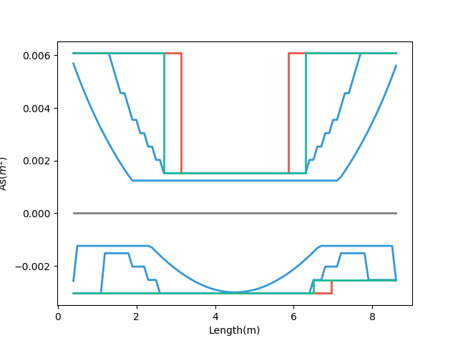
Why?
- Demand
- Tradition
- Multi-Cut-2
- Demand
- Tradition
- Multi-Cut-2
Small Gravity 89%
Bottom
Large Gravity 99%
5-#8
6-#8
5-#8
7-#8
6-#8
6-#8
High Seismic
Low Seismic
Notes:
HighSeismic 4Floor 9M 12
LowSeismic 4Floor 9M 12

Slide 30
#8 => #10
2.54cm => 3.22cm
6m
9m
12m
High Seismic
98.9%
102.2%
99.4%
Site
Middle Seismic
97.5%
100.5%
100.0%
Low Seismic
97.8%
101.7%
101.2%

Slide 31
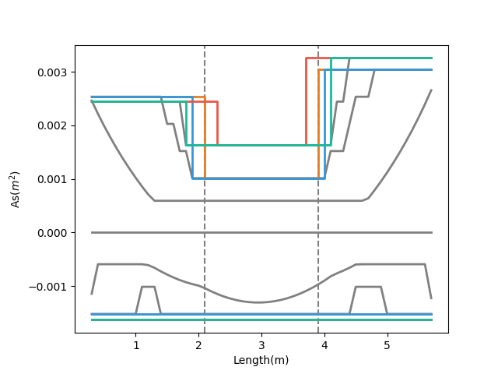
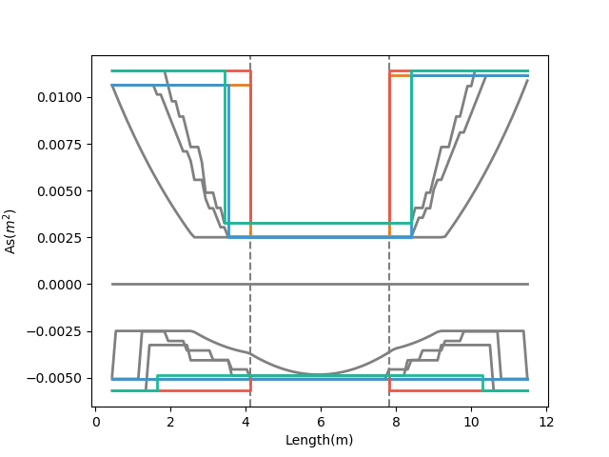
- Tradition, #8
- Tradition, #10
- Tradition, #8
- Tradition, #10
- Multi-Cut-2, #8
- Multi-Cut-2, #10
- Multi-Cut-2, #8
- Multi-Cut-2, #10
Notes:
MidSeismic 4Floor 6M 0
HighSeismic 4Floor 12M 12

Slide 32
Stories Result
Top
Bottom
Total
4
96.0%
94.3%
95.3%
Stories
12
95.3%
91.5%
93.8%
20
99.2%
93.6%
97.0%

Slide 33
Stirrups Result
Beam Length
6m
9m
12m
High Seismic
101.4%
92.0%
90.2%
Site
Middle Seismic
96.6%
94.4%
87.0%
Low Seismic
93.3%
94.1%
94.5%

Slide 34
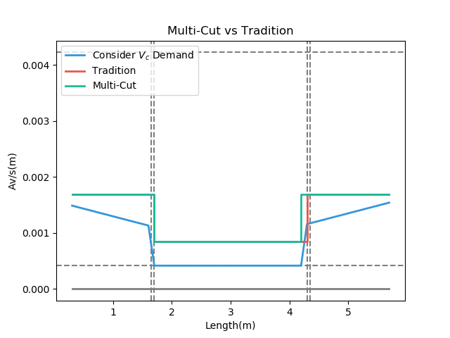
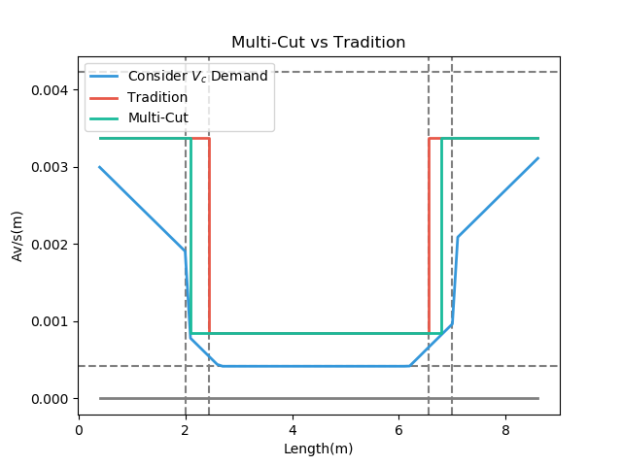
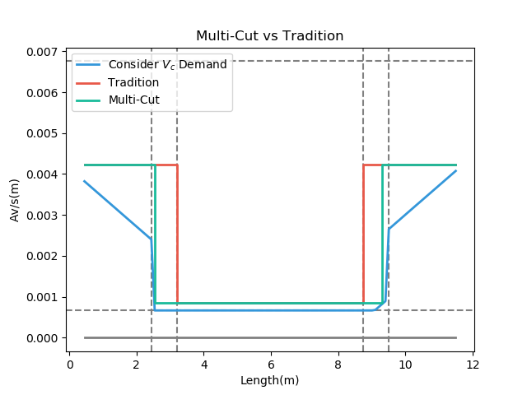
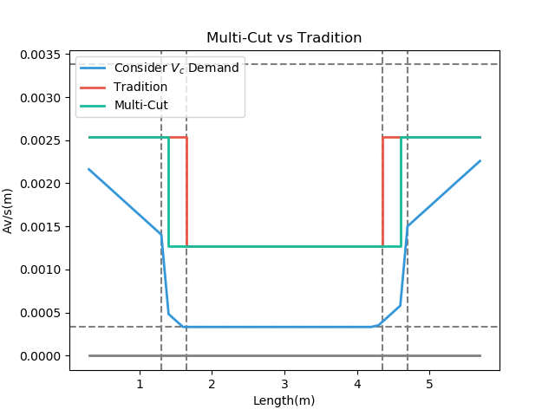
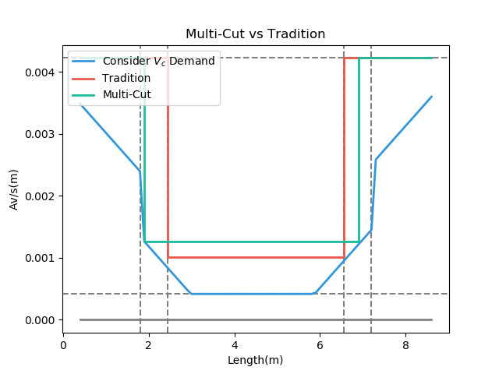
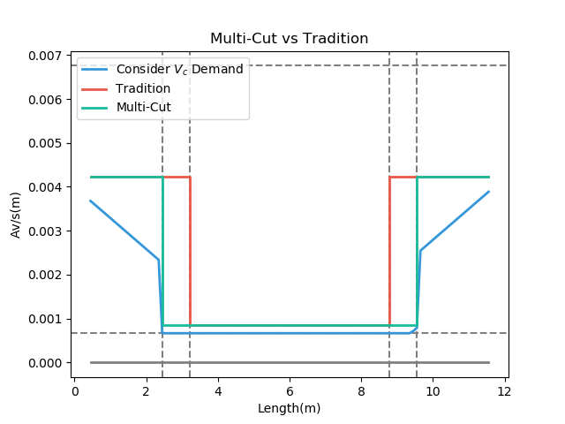
High Seismic 6m
High Seismic 9m
High Seismic 12m
Mid Seismic 6m
Mid Seismic 9m
Mid Seismic 12m
Notes:
LowSeismic 4Floor 12M 0

Slide 35
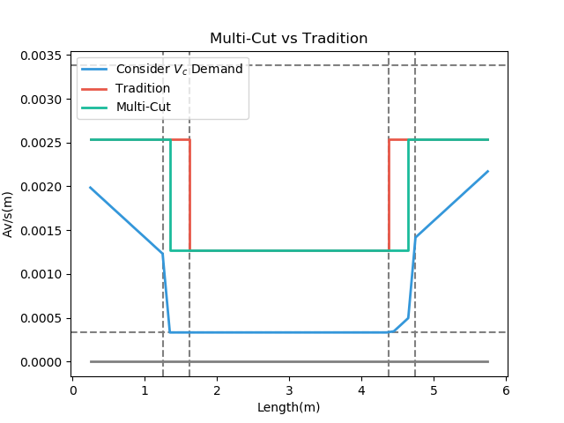
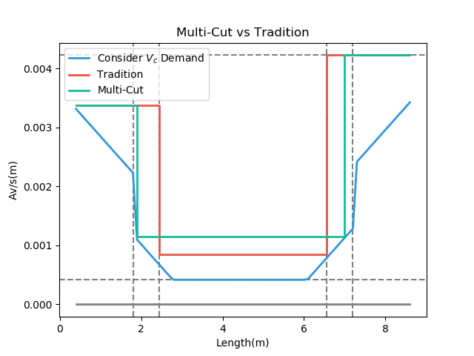
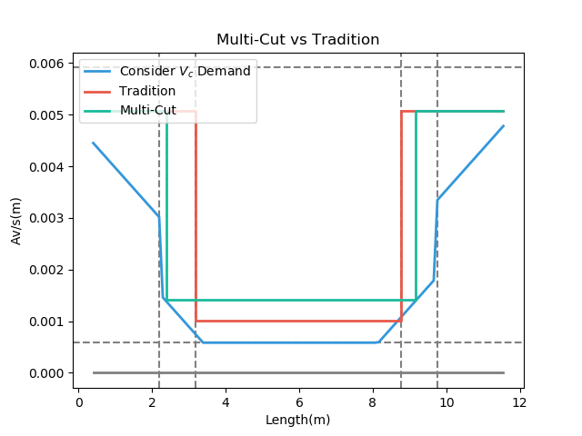
Low Seismic 6m
Low Seismic 9m
Low Seismic 12m
Mid Seismic 6m
Mid Seismic 9m
Mid Seismic 12m

Slide 36
More Multi-Cut
2
3
4
5
Unlimited
Notes:
理論最佳解

Slide 37
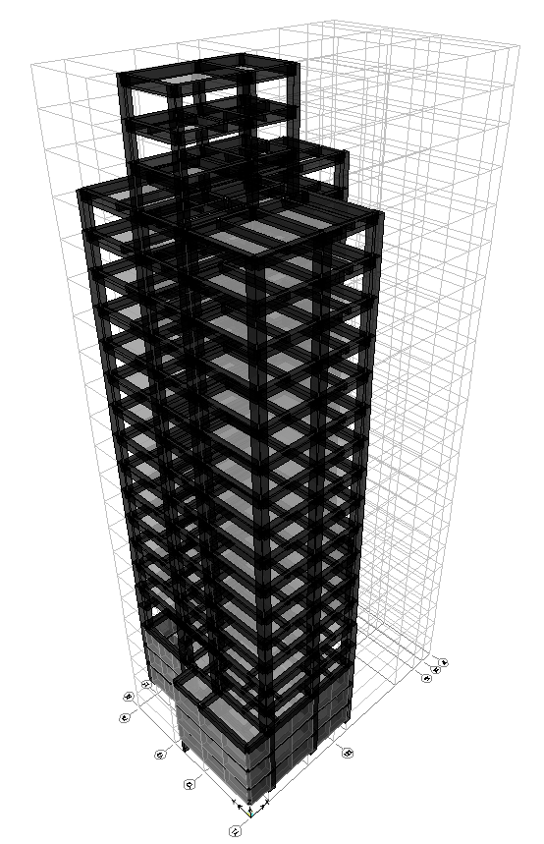
台北住宅案
100.0%
OVERALL RESULT
14F B3
101.3%
TOP RESULT
98.5%
BOT RESULT
20m
30m
Notes:
由於很複雜，先記得最終的結果
400

Slide 38
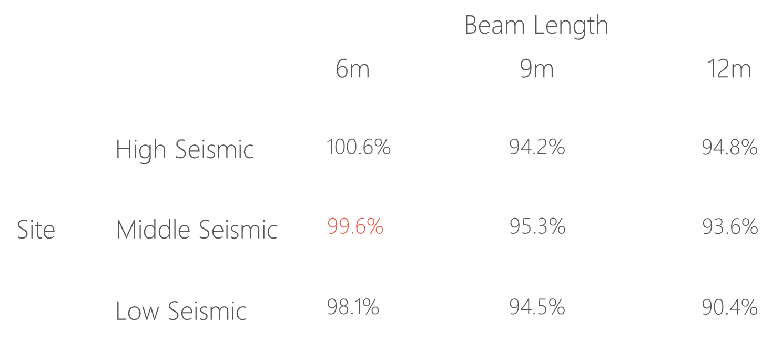
台北住宅案

Slide 39
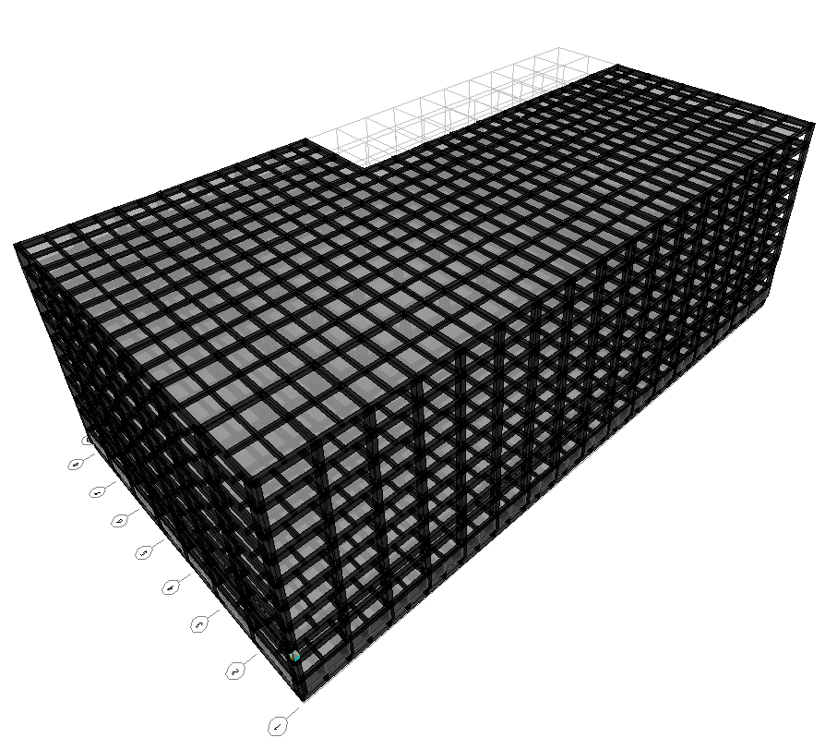
9F B1
93.4%
OVERALL RESULT
92.3%
TOP RESULT
153m
77m
94.7%
BOT RESULT
高雄物流中心
Notes:
3500

Slide 40
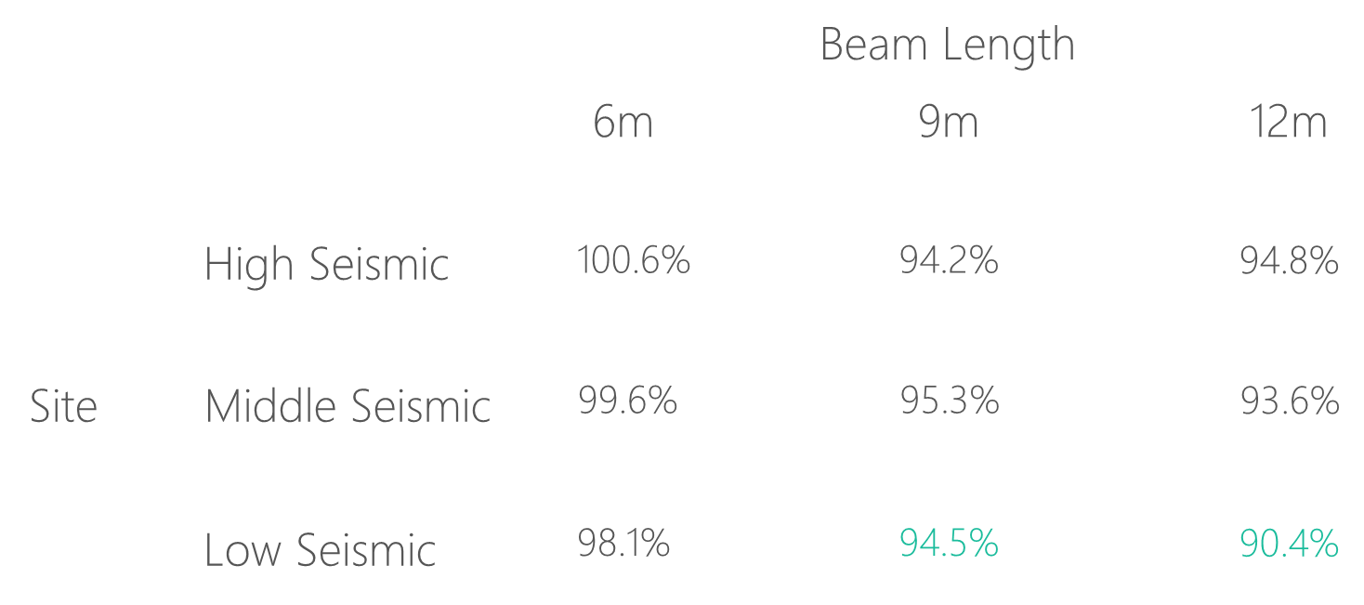
高雄物流中心

Slide 41
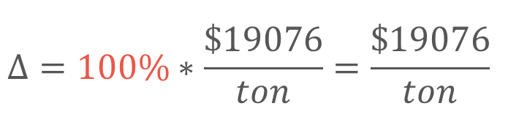
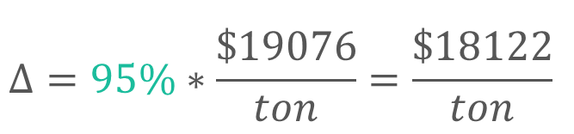
Material Cost
Tradition
Multi-Cut
$$Δ=100\%∗\frac{\$19076}{ton}=\frac{\$19076}{ton}$$
$$Δ=95\%∗\frac{\$19076}{ton}=\frac{\$18122}{ton}$$
Material Cost
Reduced Percentage
資料來源: 公共工程價格資料庫 2019

Slide 42


Construction Cost
Tradition
Multi-Cut
$$Δ=100\%∗\frac{\$5500}{ton}=\frac{\$5500}{ton}$$
$$Δ=95\%∗\frac{\$5500↑}{ton}=\frac{\$5320}{ton}$$
鋼筋綁紮工資
複雜度增加 => 鋼筋綁紮工資增加
資料來源: 台北市公共工程 2019

Slide 43






Cost Analysis
Tradition
Multi-Cut
$$100\%∗\frac{\$19076}{ton}=\frac{\$19076}{ton}$$
$$95\%∗\frac{\$19076}{ton}=\frac{\$18122}{ton}$$
Material Cost
Construction Cost
$$100\%∗\frac{\$5500}{ton}=\frac{\$5500}{ton}$$
$$95\%∗\frac{\$6794}{ton}=\frac{\$6454}{ton}$$
Total Cost
$$100\%$$
$$100\%$$

Slide 44






Cost Analysis
Multi-Cut-2
Tradition
Multi-Cut-2
$$100\%∗\frac{\$19076}{ton}$$
$$95\%∗\frac{\$19076}{ton}$$
Material Cost
Construction Cost
$$100\%∗\frac{\$5500}{ton}$$
$$95\%∗\frac{\$5500}{ton}$$
Total Cost
$$100\%$$
$$95\%$$

Slide 45
Outline
Part 2
Part 4
Algorithm
Seismic Verification
Part 1
Part 3
Objective
Condition

Slide 46


12-#10
Consider Ld
12-#10
10-#10
10-#10
Top
3-#10
3-#10
7-#8
7-#8
9-#8
Bottom
9-#8
12-#8
12-#8

Slide 47


Pushover Method
ATC-40 Capacity Spectrum
Modal Pushover Analysis
Multi-Modes Combination
Mode Shape
Effective Mass
SRSS
Notes:
定義非線性驗證的邊界

Slide 48
ATC-40 Capacity Spectrum
Tradition
Multi-Cut-2
Notes:
Low Seismic 12m 90.4%

Slide 49
Modal Pushover Analysis - Tradition
Mode 1
Mode 2

Slide 50
Modal Pushover Analysis – Multi-Cut
Mode 1
Mode 2

Slide 51
Modal Pushover Analysis - SRSS
Tradition
Multi-Cut-2

Slide 52
Multi-Modes Combination
Tradition
Multi-Cut-2

Slide 53




Step 2
Step 3
Step 5
Step 7

Slide 54
Gravity Load
Forth Hinge
Gravity Load
+
Lateral Load

Slide 55



Without Gravity Load
First Hinge

Slide 56

Time History Analysis
Story Drift
Scaled to DBE, MCE
- Time History Spectrum
- DBE Spectrum
- MCE Spectrum
DBE < 1.5%
MCE < 2%

Slide 57


DBE < 1.5%
Low Seismic 12m 90.4%
Tradition
Multi-Cut-2

Slide 58


MCE < 2.0%
Low Seismic 12m 90.4%
Tradition
Multi-Cut-2

Slide 59




Tradition DBE
Multi-Cut-2 DBE
換圖
Tradition MCE
Multi-Cut-2 MCE
Notes:
DBE 1602 11.5
MCE 1116 15.5

Slide 60





Slide 61


Incremental Dynamic Analysis
Single Static Analysis
➔
Incremental SPO
Single Time History Analysis
➔
Incremental One

Slide 62

Non-Linear SPO
Elastic
➔
Match
Non-Negative
➔
Equal Displacement
Negative
➔
Softening

Slide 63

Pushover and IDA too much difference

Slide 64


Another way IM: Base Shear

Slide 65
SF: 0.5
SF: 2.5
SF: 4.5
SF: 6.5
SF: 8.5
SF: 10

Slide 66

Result

Slide 67


Limit-State
4% FEMA273
2.5% SEAOC2000

Slide 68


IDA
Low Seismic 12m 90.4%
Log

Slide 69
Conclusion
Condition
Verification
Long Span
Low Seismic
Capacity Close To Tradition
Objective
Construction
Reduce Rebar
Today or Future Cost

